Slide 1

Advanced JAVA Programming
UNIT :- I
Applet

Slide 2
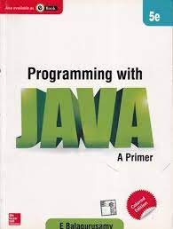
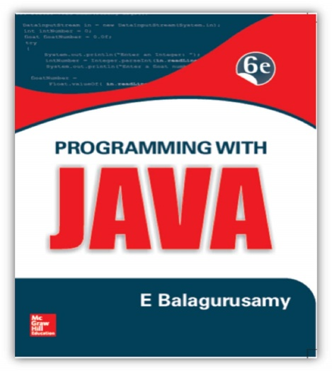



Reference Book
E. Balagurusamy, “Programming With JAVA” , Tata McGraw Hill, 6th Edition
Herbert Schildt, “ JAVA:- The Complete Reference, Tata McGraw Hill, 11th Edition

Slide 3
Applet
Java Programs are available in two flavours
Application :- It is similar to all other kind of programs like in C , C++ etc. to solve a real time problem
Applet :- Applet is small Java programs that are primarily used in internet computing
They can be transported over the Internet from one computer to another and run using the Applet viewer or any web browser that supports Java.
An applet , like any application program, can do many things for us. It can perform arithmetic operations, display graphics, play sounds, accept user input, create animation and play interactive games.
A web page can now contain not only a simple text or a static image but also a Java applet which run graphics, sounds and moving images.

Slide 4
Local and Remote Applet
We can embed applets into web pages in two ways
One , we can write our own applet and embed them into web pages
Second, we can download an applet from a remote computer system and then embed into a web page.

Slide 5
How Applets Differ from Applications
Applets and stand alone applications are Java programs
Significant difference between them:- Applets are not full featured application programs.
They are usually written to complete a small task or a component of a task.
They are usually designed for use on the internet
Applets do not use the main() method for initiating the execution of the code
Unlike stand alone application, applets can not be run independently
Applets can not read form or write to the files in the local computer
Applets can not communicate with other servers on the network
Applets can not run any program from the local computer

Slide 6
Preparing to Write Applets
Before we try to write applets, we must make sure that Java is installed properly, and also ensure that either the Java appletviewer or a Java enabled browser is available
Steps involved in developing and testing in applet are
Building an applet code (.java file)
Creating an executable applet (.class file)
Designing a web page using HTML tag
Preparing <APPLET>tag
Incorporating <APPLET> tag into the web page
Creating HTML file
Testing the applet code

Slide 7
Building Applet Code
Our applet code use the services of two classes, namely, Applet and Graphics from the Java class library.
Applet class which is contained in the java.applet package provides life and behaviour of applet through its methods such as init(), start(), paint(), close().
Therefore Applet class is the life cycle of applet.
paint () method of the Applet class, when it is called, actually displays the result of the applet code on the screen. Output may be text, graphics, sound etc.
paint() method, which requires a Graphics object as an argument is defined as
public void paint(Graphics g)
This requires that the applet code import the java.awt package that contain the Graphics class.
All output operation of an applet are performed using the methods defined in the Graphics class.

Slide 8
Building an Applet Code
Process-1) Import Applet and Graphics class from applet and awt package respectively
Process -2) Define applet class from extending the properties of Applet class
Process-3) Override the method paint that shows the result of applet code
Process -4) By using object of Graphics class access the methods that perform the all operation of applet
Compile this file to creating a .class file for execution of applet code
//File Name is :- AppletClassName.java
import java.applet.Applet;
import java.awt.Graphics;
public class AppletClassName extends Applet
{
-----------------
public void paint(Graphics g)
{
-----------
-----------
}
---------------
---------------
}

Slide 9
Testing a Applet Code
We know the applet are programs that reside on web pages. In order to run a Java applet, it is first necessary to have a web page that references that applet.
Basically web page made up of text and HTML tags that can be interpreted by web browser or an applet viewer.
A web page also called as HTML page
A web page is marked by an opening HTML tag <HTML> and a closing HTML tag </HTML> and its divided into three major sections:
Comment Section (Optional)
Head Section ( Optional)
Body Section

Slide 10
Testing a Applet Code
<HTML>
</HTML>
Comment Section
<!
---- -------
-------------
>
Head Section
<HEAD>
Title Tag
</HEAD>
Body Section
<BODY>
Applet Tag
</BODY>
<applet code = “AppletClassName.class” width =“300” Height=“300”>
</applet>
Save as .html and use appletviewer filename.html commaned to run our applet code

Slide 11
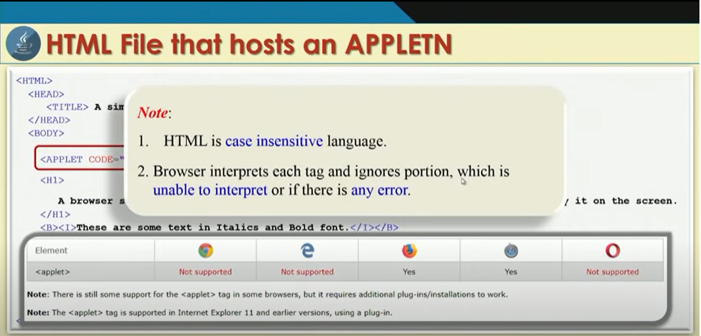

Slide 12
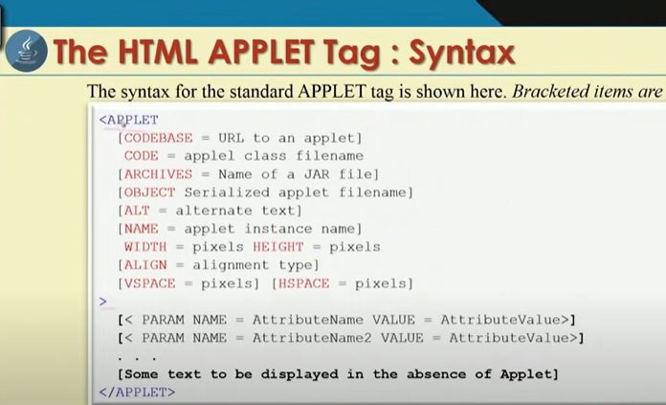

Slide 13
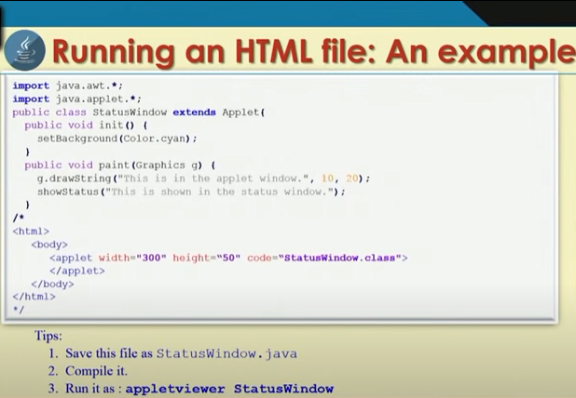

Slide 14
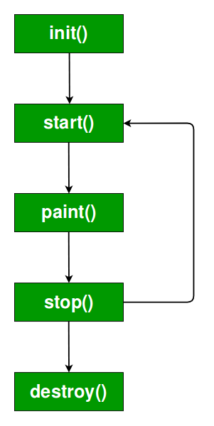
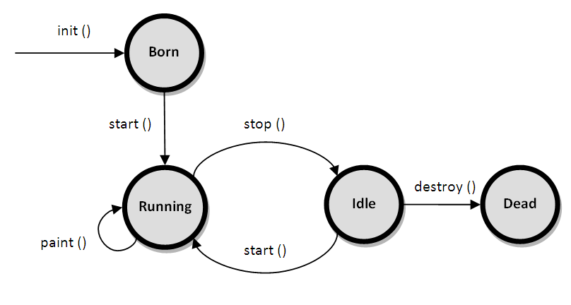
Applet Life Cycle

Slide 15
Basic Methods of Applet
public void init() – To initialize or pass input to an applet
public void start()- start() called after the init() method and it starts an applet
public void stop()- To stop running applet
public void paint(Graphics G)- To draw something within an applet
Public void destroy() – To remove an applet from memory completely

Slide 16
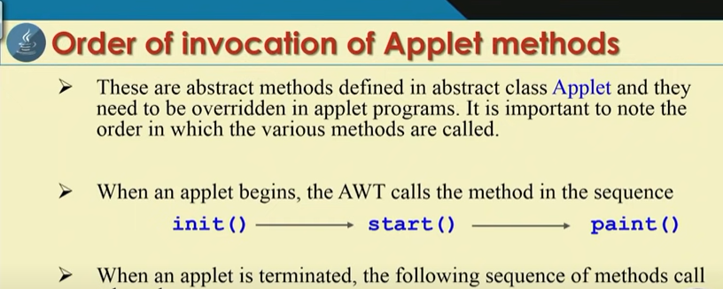


Slide 17
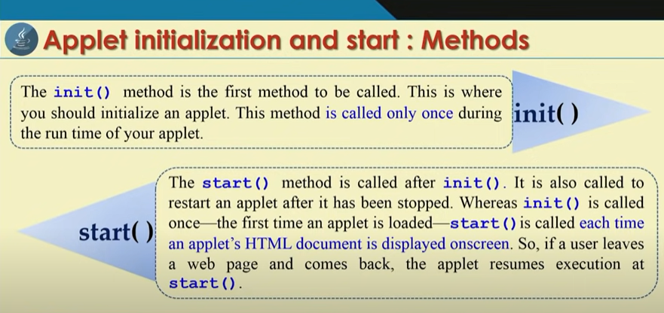

Slide 18
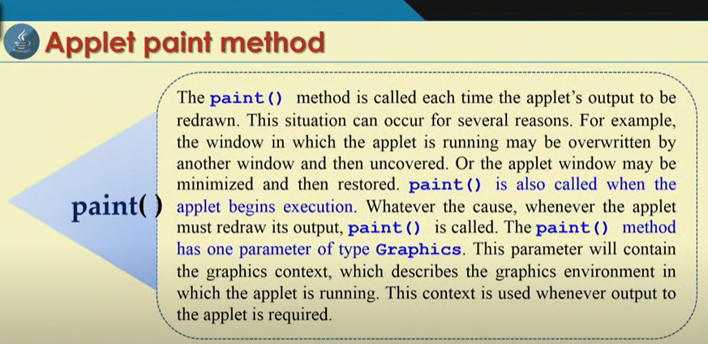

Slide 19
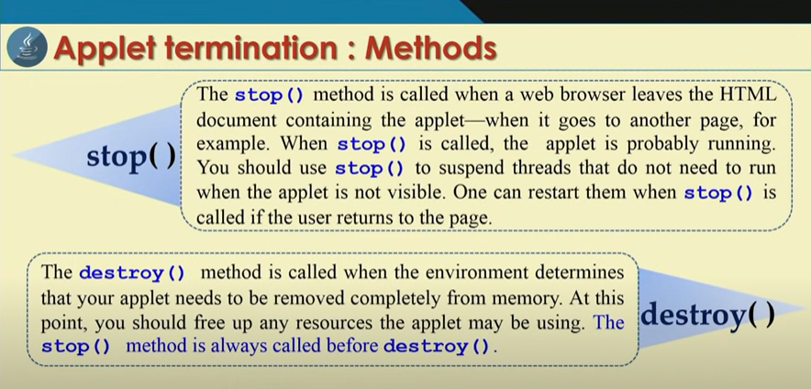

Slide 20
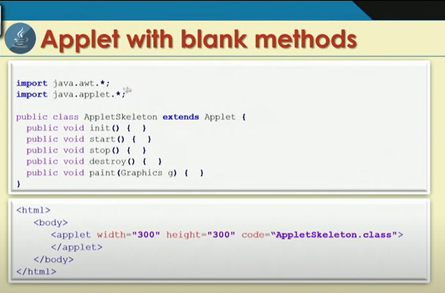
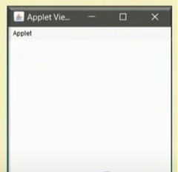

Slide 21
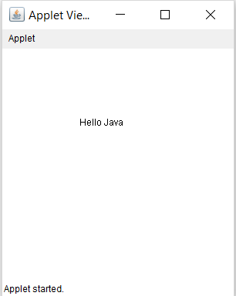
Example :- Print the Hello Java on Applet Window
import java.awt.*;
import java.applet.*;
public class HelloJava extends Applet
{
public void paint(Graphics g)
{
g.drawString("Hello Java", 100,100);
}
}
/*
<html>
<body>
<applet code= "HelloJava.class" width ="300" height="300" >
</applet>
</body>
</html>
*/
*/

Slide 22
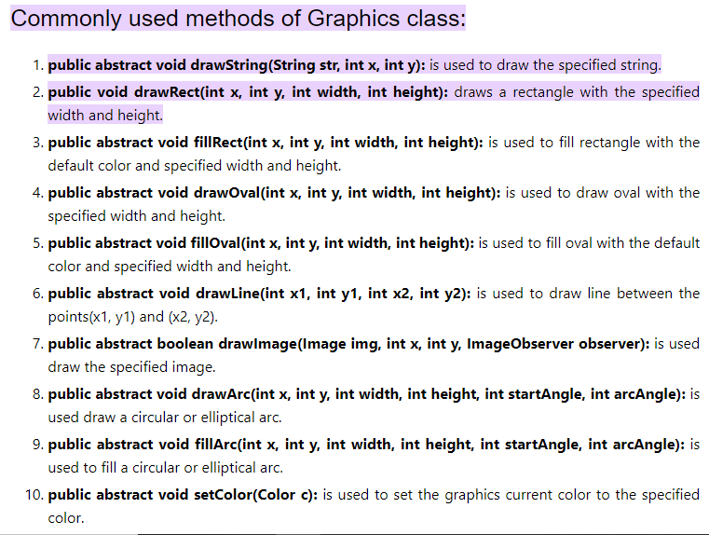

Slide 23
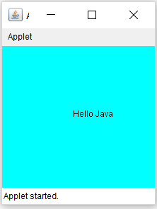
Example
import java.awt.*;
import java.applet.*;
public class HelloJava extends Applet
{
public void init()
{
resize(200,200);
setBackground(Color.cyan);
}
public void paint(Graphics g)
{
g.drawString("Hello Java", 100,100);
}
}
/*
<html>
<body>
<applet code= "HelloJava.class" width ="300" height="300" >
</applet>
</body>
</html>
*/

Slide 24
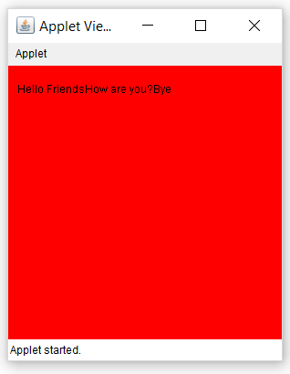
import java. applet.*;
import java. awt.*;
public class Sample extends Applet
{
String msg;
public void init()
{
setBackground(Color.red); // set background and forground color
of applet window
setForeground(Color.black);
msg="Hello Friends .... "; // initialize the string to dispaly
}
public void start()
{
msg += "How are you?....";
}
public void paint(Graphics g)
{
msg+= "Bye…….";
g.drawString(msg,10,30);
}
}
/*
<html>
<body>
<applet code="Sample.class" width="300" height="300">
</applet>
</body>
</html>
*/

Slide 25
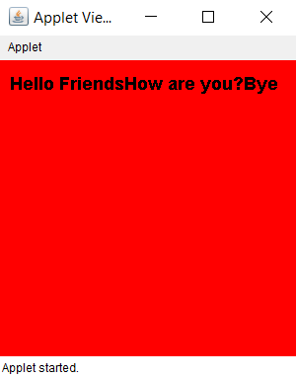
import java. applet.*;
import java. awt.*;
public class Sample extends Applet
{
String msg;
Font f1;
public void init()
{
setBackground(Color.red); // set background and forground color
of applet window
setForeground(Color.black);
msg="Hello Friends .... "; // initialize the string to display
f1 =new Font (“Aerial”,Font.BOLD, 18);
}
public void start()
{
msg += "How are you?....";
}
public void paint(Graphics g)
{
msg+= "Bye…….";
g.setFont(f1);
g.drawString(msg,10,30);
}
}
/*
<html>
<body>
<applet code="Sample.class" width="300" height="300">
</applet>
</body>
</html>
*/

Slide 26
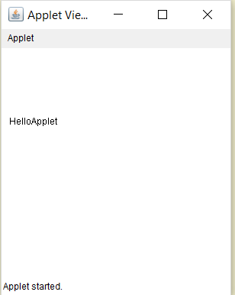
Passing a Parameter to Applet
import java.applet.Applet;
import java.awt.Graphics;
public class Test extends Applet
{
String str;
public void init()
{
str=getParameter("string");
if (str ==null)
str= "Java";
str="Hello"+str;
}
public void paint(Graphics g)
{
g.drawString(str,10,100);
}
}
/*
<html>
<body>
<applet code="Test.class" width="300" height="300">
<param name="string" value="Applet">
</applet>
</body>
</html>
*/

Slide 27
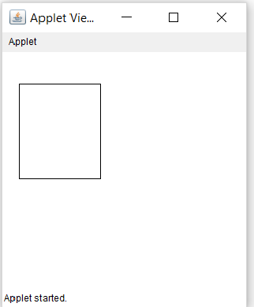
Passing a Parameter to Applet
import java.awt.Graphics;
import java.applet.Applet;
public class Rectangle extends Applet
{
int x,y,w,h;
public void init()
{
x=Integer.parseInt(getParameter("xValue"));
y=Integer.parseInt(getParameter("yValue"));
w=Integer.parseInt(getParameter("wValue"));
h=Integer.parseInt(getParameter("hValue"));
}
public void paint(Graphics g)
{
g.drawRect(x,y,w,h);
}
}
/*
<html>
<body>
<applet code="Rectangle.class" width="300" height="300">
<param name="xValue" value="20">
<param name="yValue" value="40">
<param name="wValue" value="100">
<param name="hValue" value="120">
</applet>
</body>
</html>
*/

Slide 28
Passing a Parameter to Applet
import java.awt.*;
import java.applet.*;
public class UserIn extends Applet
{
TextField text1, text2;
public void init()
{
text1=new TextField(8);
text2=new TextField(8);
add(text1);
add(text2);
text1.setText("0");
text2.setText("0");
}
public void paint(Graphics g)
{
int x=0,y=0,z=0;
String s1,s2,s;
g.drawString("Input a number in each box",10,50);
try
{
s1=text1.getText();
x= Integer.parseInt(s1);
s2=text2.getText();
y=Integer.parseInt(s2);
}
catch(Exception e)
{}
z=x+y;
s= String.valueOf(z);
g.drawString("The sum is:",10,75);
g.drawString(s,100,75);
}
}
/*
<html>
<body>
<applet code ="UserIn.class" width="300" height="300">
</applet.
</body>
<html>
*/

Slide 29
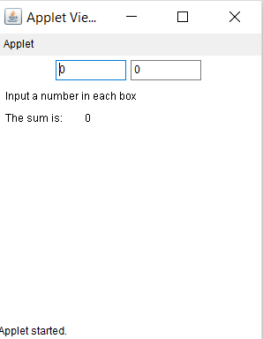
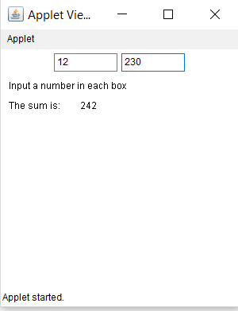
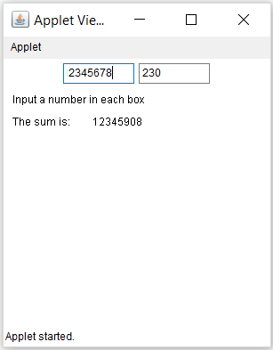
Passing a Parameter to Applet

Slide 30
getCodeBase() and getDocumentBase()
1) getCodeBase() :- JAVA will allow the applet to load the directory from which the applet’s class file was loaded
Get the base url
2) getDocumentBase():- JAVA will allow the applet to load the data from the directory holding the HTML file that started the applet (document base)
Get URL of the document in which the applet is embedded.

Slide 31
JApplet
Called as Swing Applet
Second type of program that commonly uses swing is applet
Swing based applets are similar to AWT based applet but with an important difference
Swing applet extends the JApplet rather than Applet
JApplet includes all of the functionality founds in Applet and adds support for Swing.
Swing applets use the same four life cycle methods as init(), start(), stop(), destroy()

